Slide 1

Forest Health Pests and Diseases & Biosecurity
USDA-APHIS
Texas Invasive Species Institute (TISI)
SHSU Agriculture Sciences
SHSU Engineering Technology

Slide 2
TEKS / OBJECTIVES
TEKS: 130.25 10 A-G The student describes the relationship between resources within environmental systems.
Objectives:
Students will evaluate exotic wood-boring pests in Texas by APHIS
Students will compare educational initiatives and programs for forest health and pests.

Slide 3
Warm-up Question
What are some identifying characteristics of pests?
Log your answer in your guided notes sheet.

Slide 4
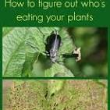
Pest ID Characteristics
Size and shape
Elongated, oval, round, segmented
Color
Observe the pest's color and any distinctive markings like stripes, spots, or patterns.
Presence and type of wings and legs
How many wings and legs? What color are the wings?
The presence and type of antennae
Mouthparts and damage to plants caused
Different types of mouthparts (chewing, piercing-sucking, sponging, siphoning) can indicate the pest's feeding habits and help with identification.
Notes:
Understanding these features, along with the pest's life cycle and the type of damage it causes, is crucial for effective pest management.
Proper identification can save time and money by avoiding unnecessary treatments.

Slide 5

Anticipation Questions
What is a wood-boring pest?
What kind of initiatives do you know about forest health and pests?
What kind of wood-boring pests would you suspect could impact Texas?

Slide 6
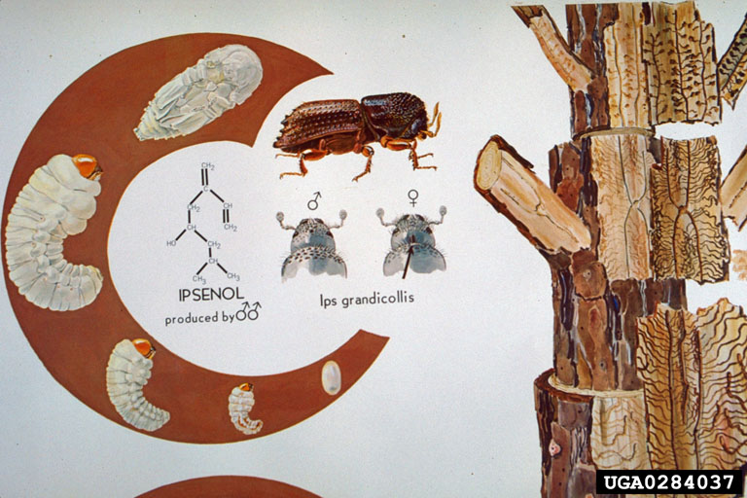
Lifecycle of Wood-boring and Bark Beetles
Adults bore into trees to feed on the phloem and xylem in the sapwood.
Notes:
Ips grandicollis is a native bark beetle species that can become problematic after drought in Texas.
This lifecycle is typical of Ips and all the bark beetle species that will be discussed in this lesson.
Ronald F. Billings, Texas A&M Forest Service , Bugwood.org

Slide 7
Lifecycle of Wood-boring and Bark Beetles
Adults create feeding galleries within the tree.
This is also how they can spread disease/fungus to trees.
Notes:
Ronald F. Billings, Texas A&M Forest Service , Bugwood.org

Slide 8
Lifecycle of Wood-boring and Bark Beetles
Eggs and larvae also in the galleries. Larvae become pupae then turn to adults.
Adults emerge from the tree and can find another host.
Notes:
Ronald F. Billings, Texas A&M Forest Service , Bugwood.org

Slide 9
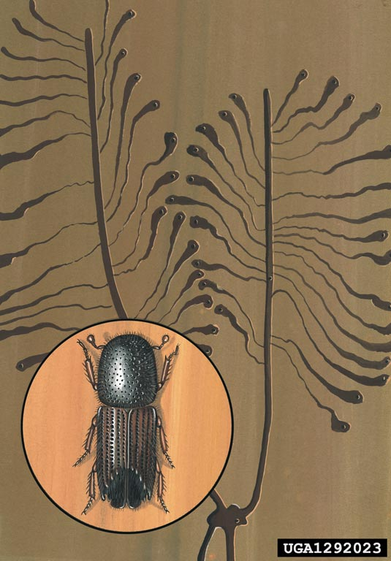
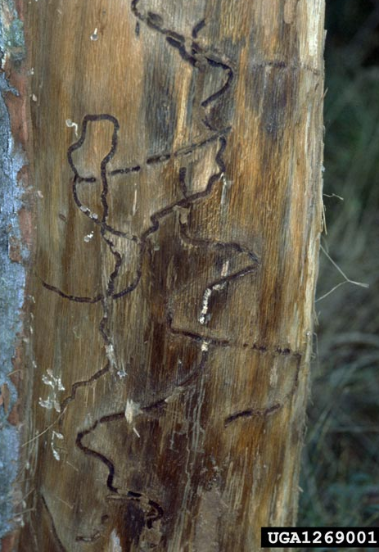
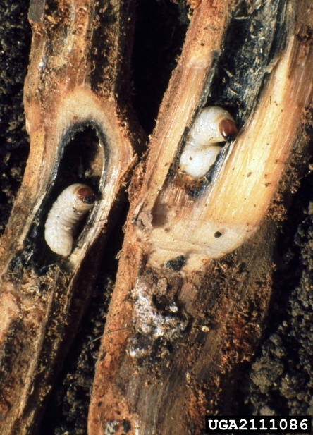
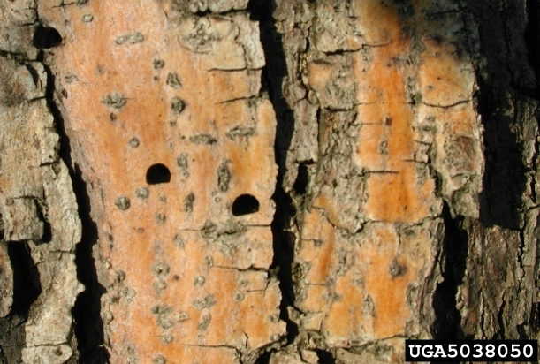
Video Recap of Lifecycle
This video from Salt Lake Tribune shows symptoms of pine beetle infestation.
Note: Discusses native bark beetles that infest damaged or stressed trees.
Over the next slides think about…
What is the difference about Invasive Bark Beetles?

Slide 10
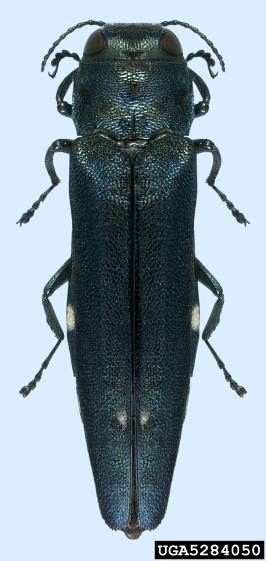

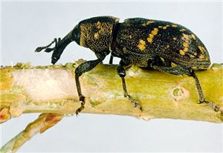
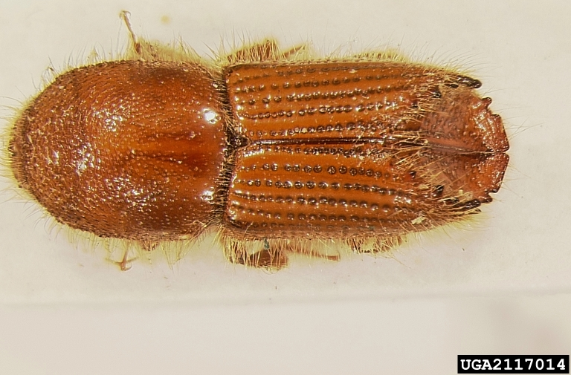
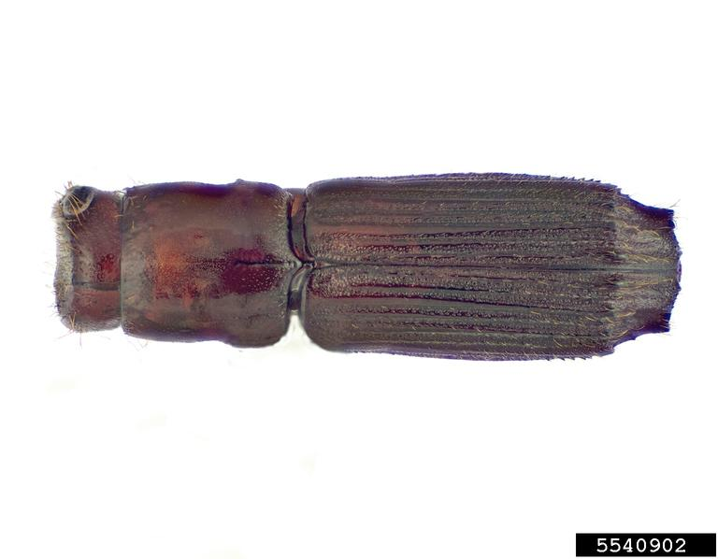
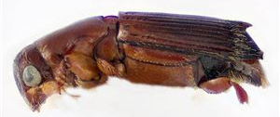
PPA Priority Pests: Forest Health Threats
Oak Splendour Beetle Agrilus biguttatus
Large Pine Weevil Hylobius abeitus
Six-toothed pine engraver Ips sexdentatus
Megaplatypus mutatus NCN
Oak Ambrosia Beetle Platypus quercivorus
Notes:
NCN: No common name but a generic term would be “Ambrosia Beetle”
SCREENING AIDS FOR ALL KINDS OF PESTS: http://caps.ceris.purdue.edu/screening-aids
PHOTOS & PRONUNCIATION:
Agrilus: Natasha Wright, Braman Termite & Pest Elimination, Bugwood.org
“A-grill-uss”
Hylobius: https://www.cabi.org/isc/datasheet/28175#toPictures
“Hi-low-bye-us”
IPS PHOTO: Jim Stimmel, Pennsylvania Department of Agriculture, Bugwood.org
Like “tips” but without the T
Megaplatypus: Joseph Benzel, Screening Aids, USDA APHIS PPQ, Bugwood.org
“Mega-pla-tie-puss”
Platypus: http://download.ceris.purdue.edu/file/2811
Like the platypus mammal “Pla-tie-puss”

Slide 11
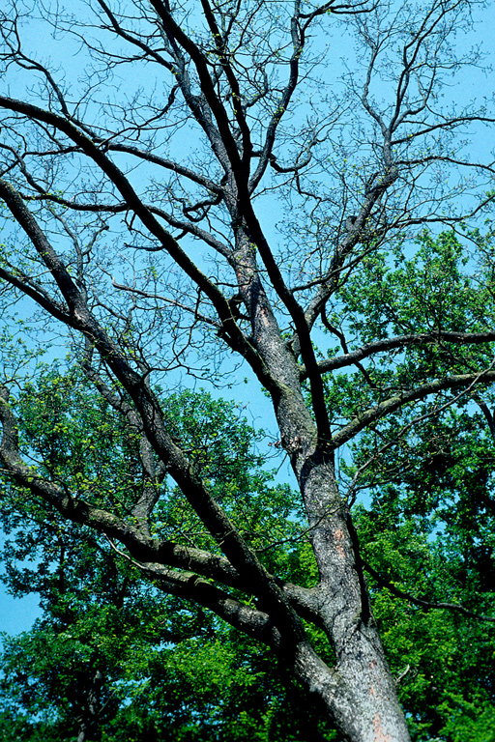
Agrilus biguttatus Oak Splendour Beetle
Host species: All Oak species (Quercus spp.), healthy or stressed.
Native to: Europe and North Africa.
Symptoms of Infestation:
Tree canopy dieback
Top branches die before the lowest ones.
D-shaped exit holes from adults entering the tree
Economic & Ecological Damage:
Texas is the 5th largest lumber producer for the United States.
Ecological: Oaks trees are necessary components of our state’s Post Oak Savannah, Blackland Prairies, Gulf coastal Marshes and the Pineywoods ecoregions.
Notes:
Dead Oak photo: Louis-Michel Nageleisen, Département de la Santé des Forêts, Bugwood.org
Insect photo: Natasha Wright, Braman Termite & Pest Elimination, Bugwood.org
D-shaped Holes: Joseph O’Brien USDA Forest Service, Bugwood.org
RESOURCES:
https://www.invasive.org/browse/subinfo.cfm?sub=4101
https://www.forestresearch.gov.uk/tools-and-resources/fthr/pest-and-disease-resources/two-spotted-oak-buprestid-agrilus-biguttatus/

Slide 12
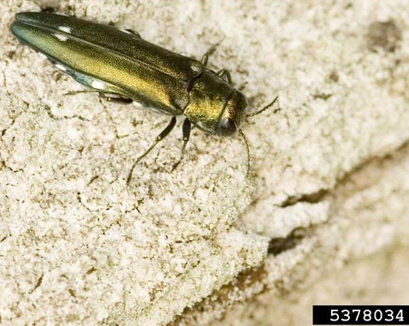
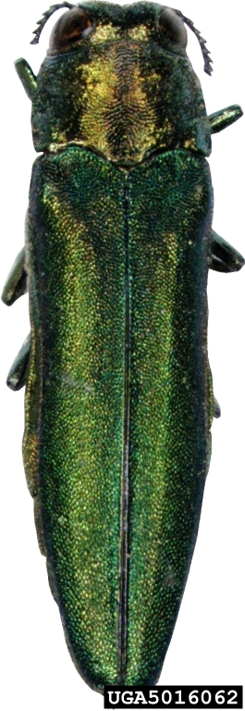
Agrilus biguttatus Oak Splendour Beetle
Identification:
Metallic green-gold color; ½ inch long
Only two white spots on the back of wings (elytra)
White marks on the interior edge
Larvae feed on tree cambium creating ‘zig-zag’ galleries.
Since they are both Agrilus species, OSB can be confused with the infamous invasive Emerald Ash Borer.
EAB is only in Ash trees and OSB is only in Oaks.
NO white spots
Notes:
OSB photo: Milan Zubrik, Forest Research Institute - Slovakia, Bugwood.org
Bark galleries photo: Beat Forster, Swiss Federal Institute for Forest, Snow and Landscape Research, Bugwood.org
EAB photo: Pennsylvania Department of Conservation and Natural Resources - Forestry , Bugwood.org
RESOURCES:
https://www.invasive.org/browse/subinfo.cfm?sub=4101
https://www.forestresearch.gov.uk/tools-and-resources/fthr/pest-and-disease-resources/two-spotted-oak-buprestid-agrilus-biguttatus/
SCREENING AID: https://caps.ceris.purdue.edu/wp-content/uploads/2025/07/Agrilus-biguttatus_CPHST-Datasheet-2014-version.pdf

Slide 13
Your Turn!
Follow the instructions on the handout to cover the rest of the pests!
Be ready for a gallery walk with your Invasive Pest Log Book.

Slide 14
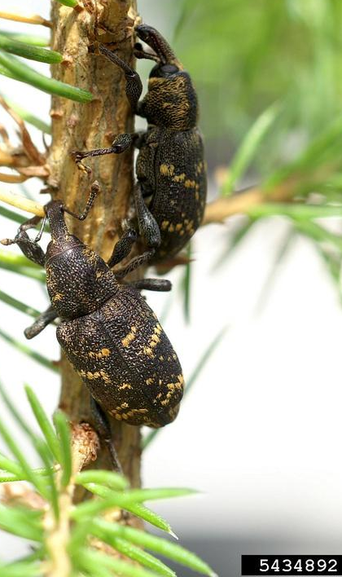
Hylobius abeitus Large Pine Weevil
Host Species: All species of Pine (Pinus) and spruce (Picea), healthy or stressed.
Native to: Europe and Northern Asia
Symptoms of Infestation:
Young tree decline from feeding.
Dieback of branches.
Stem gridling and eventual tree death
Economic & Ecological Damage:
Texas is the 5th largest lumber producer for the United States.
Over 950,000 tons of Pine lumber produced in 2020.
Ecological: Pine trees are a vital to TX ecosystems and are necessary for balance in our forested habitats.
Notes:
FACT SHEET AND RESOURCES:
https://caps.ceris.purdue.edu/wp-content/uploads/2025/07/Hylobius-abietis-CAPS-Datasheet-2017.pdf
https://www.cabi.org/isc/datasheet/28175#toPictures
LUMBER RESOURCE (2020): https://tfsweb.tamu.edu/uploadedFiles/TFSMain/Manage_Forest_and_Land/Landowner_Assistance/Timber_Harvesting/Timber_Price_Trends/Annual%20price%20report%202020.pdf

Slide 15
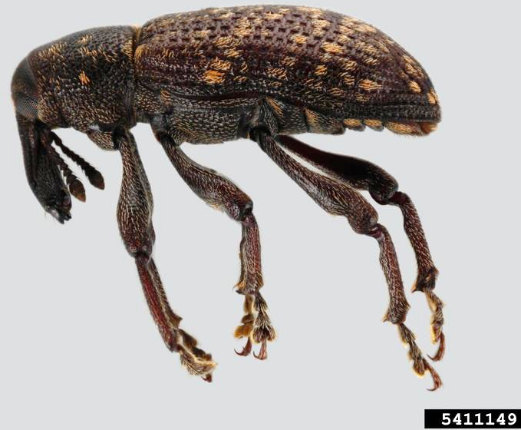
Hylobius abeitus Large Pine Weevil
Identification:
Larger Black Weevil (3/8 – 5/8 in)
Wings (elytra) have BRIGHT yellow spots
Head has two large patches of yellow hairs
Attacks healthy seedling and trees.
There is a native species present in Texas. Hylobius pales
The main difference: it has PALE yellow spots
This species can kill Pines but usually only after draught or extreme stress to the trees.
NATIVE SPECIES
Notes:
FACT SHEET AND RESOURCES:
https://caps.ceris.purdue.edu/wp-content/uploads/2025/07/Hylobius-abietis-CAPS-Datasheet-2017.pdf
https://www.cabi.org/isc/datasheet/28175#toPictures
https://www.forestresearch.gov.uk/tools-and-resources/fthr/pest-and-disease-resources/large-pine-weevil-hylobius-abietis/

Slide 16
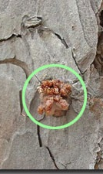
Ips sexdentatus Six-toothed Pine Engraver
Host Species: All species of Pine (Pinus) and spruce (Picea)
Native to: Europe and Northern Asia
Symptoms of Infestation:
Canopy dieback and discoloration.
Will attack healthy pines in invaded areas.
Bark flakes off to reveal eating galleries made by adults and larvae.
Sap oozes from small entrance holes
Economic & Ecological Damage:
Texas is the 5th largest lumber producer for the United States.
Ecological: Pine trees are a vital to TX ecosystems and are necessary for balance in our forested habitats.
Notes:
RESOURCES:
https://www.cabi.org/isc/datasheet/28839#toPictures
FACT SHEET: http://download.ceris.purdue.edu/file/3086 SCREENING AID: https://www.barkbeetles.org/exotic/ipsxdnts.html & http://download.ceris.purdue.edu/file/2798
A&M Forest Service with photos of Ips beetle attacks: https://tfsweb.tamu.edu/EvidenceOfBeetleAttacks/
Insect picture: Jim Stimmel, Pennsylvania Department of Agriculture, Bugwood.org
Insect galleries photo: Robert Dzwonkowski, Bugwood.org

Slide 17
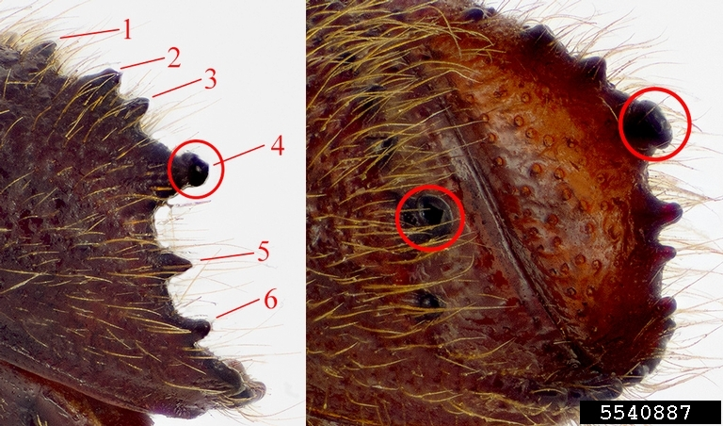
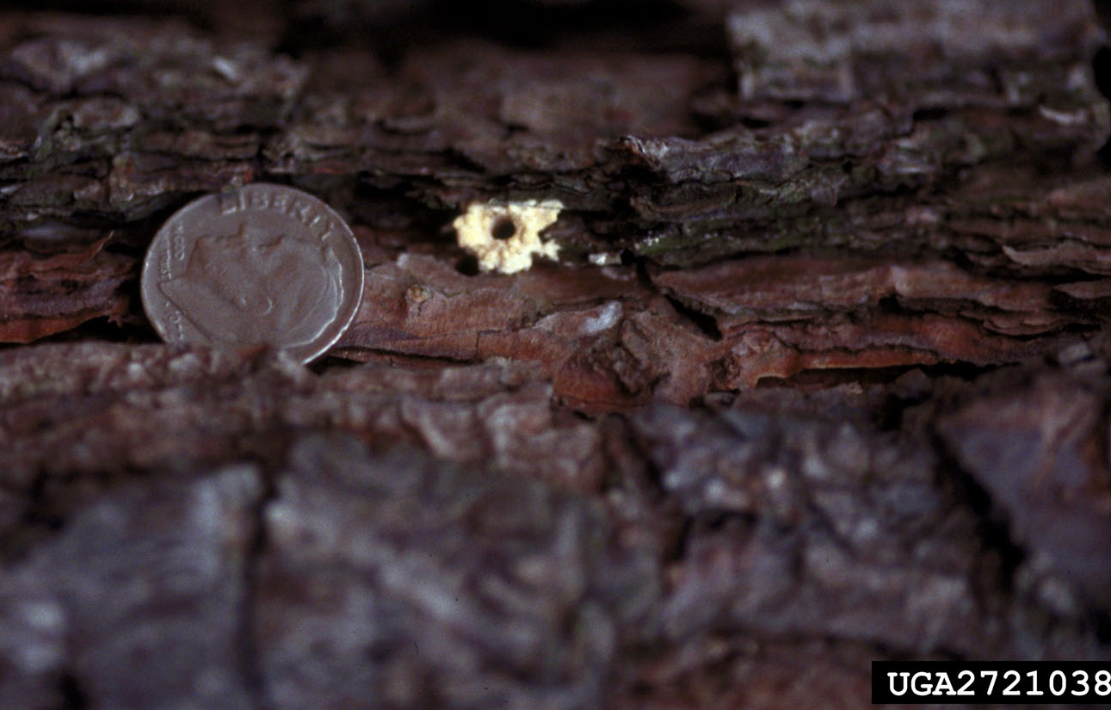
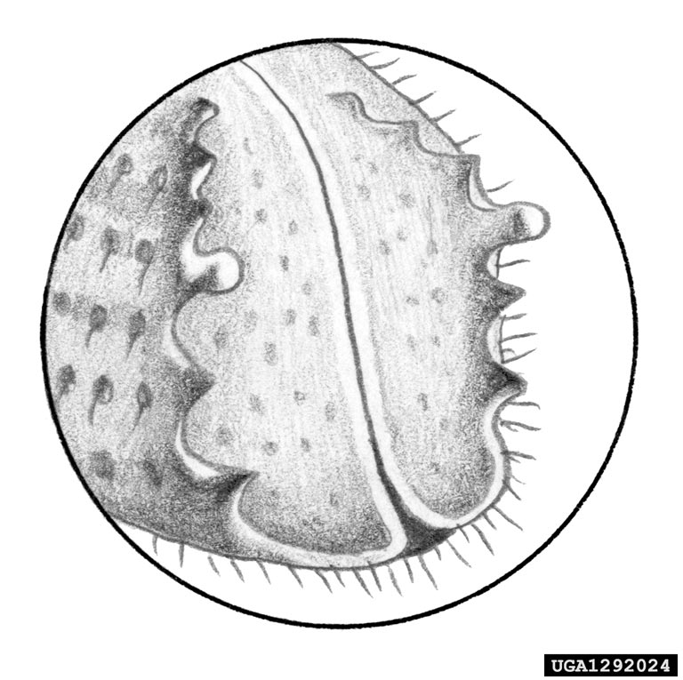
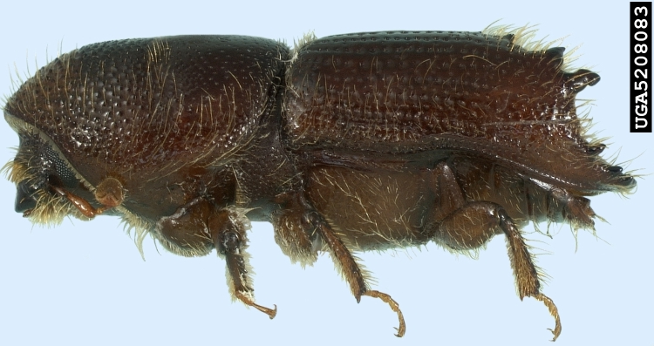
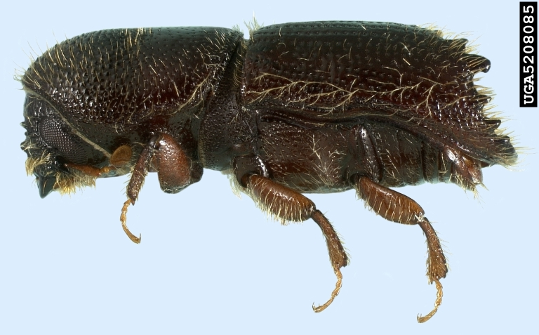
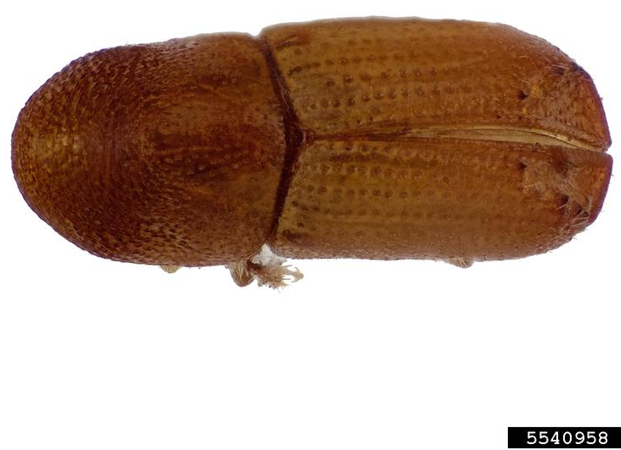
Ips sexdentatus Six-toothed Pine Engraver
Identification
Ips are small beetles
This one is a larger Ips at 6-8mm
This species has 6 spines on the backend of their wings (elytra)
4th spine being largest is an important trait.
Entrance holes on trees are very small like a pin.
There are MANY native Ips species in the US. They also kill trees but usually after draught or other stressors to the tree.
Notes:
RESOURCES:
https://www.cabi.org/isc/datasheet/28839#toPictures
FACT SHEET: http://download.ceris.purdue.edu/file/3086
SCREENING AID: https://www.barkbeetles.org/exotic/ipsxdnts.html & http://download.ceris.purdue.edu/file/2798
**IMPORTANT**: Ips are separated by the number of spines on their backend AND how those spines are formed (i.e.: which ones are largest) the native Ips calligraphus DOES HAVE 6 SPINES AS WELL but the formation is different from invasive Ips sexdentatus.
Spike counting picture: Joseph Benzel, Screening Aids, USDA APHIS PPQ, Bugwood.org
Line drawing of spikes: Robert Dzwonkowski, Bugwood.org
Other ips photo credits (left to right)
Ips calligraphus (far left): Natasha Wright, Braman Termite & Pest Elimination, Bugwood.org
Ips avulsus: Joseph Benzel, Screening Aids, USDA APHIS PPQ, Bugwood.org
Ips grandicollis: Natasha Wright, Braman Termite & Pest Elimination, Bugwood.org

Slide 18
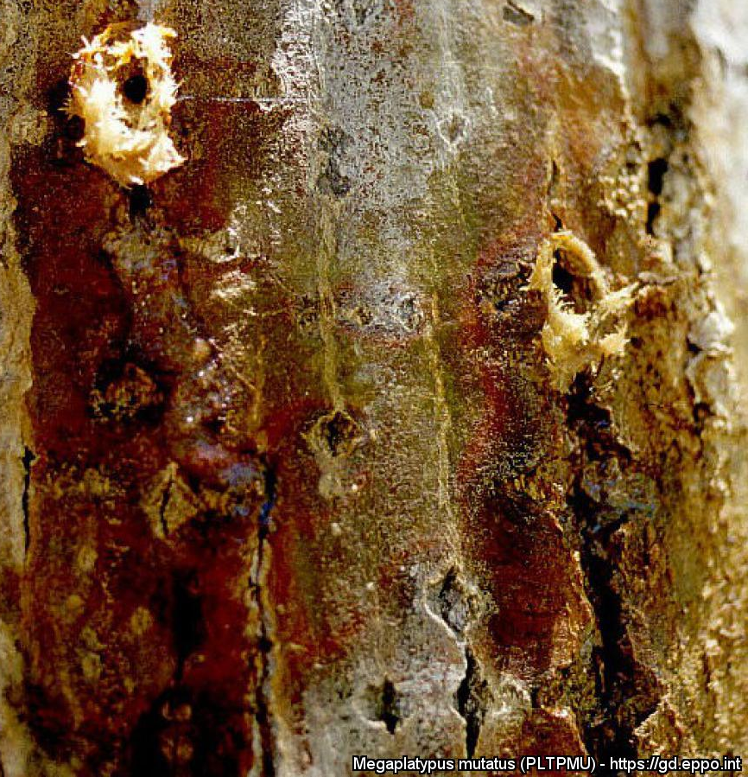
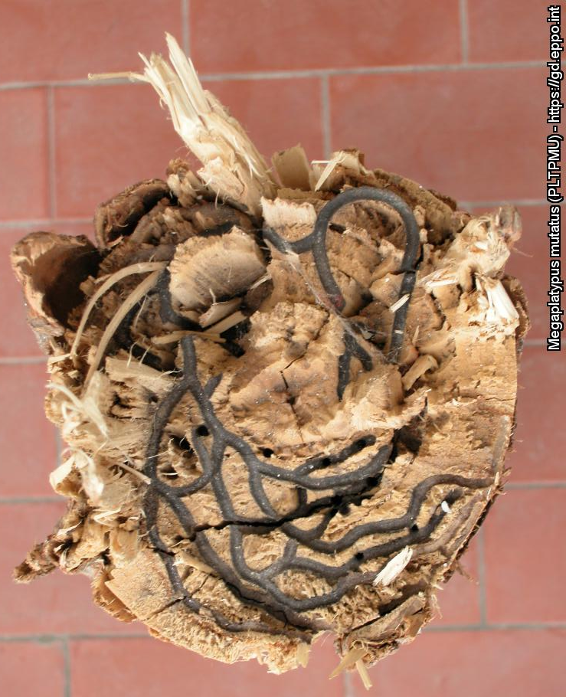
Megaplatypus mutatus
Host Species: Walnut, Maple, Cottonwood, Oaks (and many other species)
Native to: South America
Symptoms of Infestation:
Adults bore through to the xylem; coarse sawdust and sap found around the holes.
Create “simple” feeding galleries throughout the tree (not just under the bark) and can spread fungus.
Economic & Ecological Damage:
Maple Syrup: $38 Million/ year in US alone.
Ecological: Significant threat to TX and Eastern US Forests, since it can attack numerous tree species that are vital for ecosystems.
Notes:
Insect Photo: Joseph Benzel, Screening Aids, USDA APHIS PPQ, Bugwood.org
Holes photo: G. Allegro, CRA- Istituto di Sperimentazione per la Pioppicoltura, Casale Monferrato (IT).
Feeding galleries photo: R. Griffo, NPPO Campania region, Napoli (IT).
RESOURCES:
https://www.cabi.org/isc/datasheet/42293
http://download.ceris.purdue.edu/file/3071
https://gd.eppo.int/taxon/PLTPMU/datasheet
SCREENING AID: http://download.ceris.purdue.edu/file/2811
MAPLE SYRUP STATS: https://extension.psu.edu/maple-syrup-production#:~:text=Maple%20syrup%20production%20in%20the%20United%20States%20is,an%20average%20income%20of%20slightly%20over%20%2437.5%20million.

Slide 19
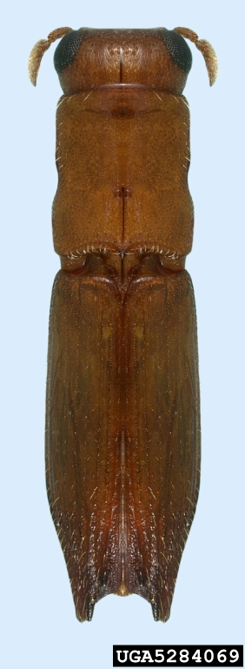
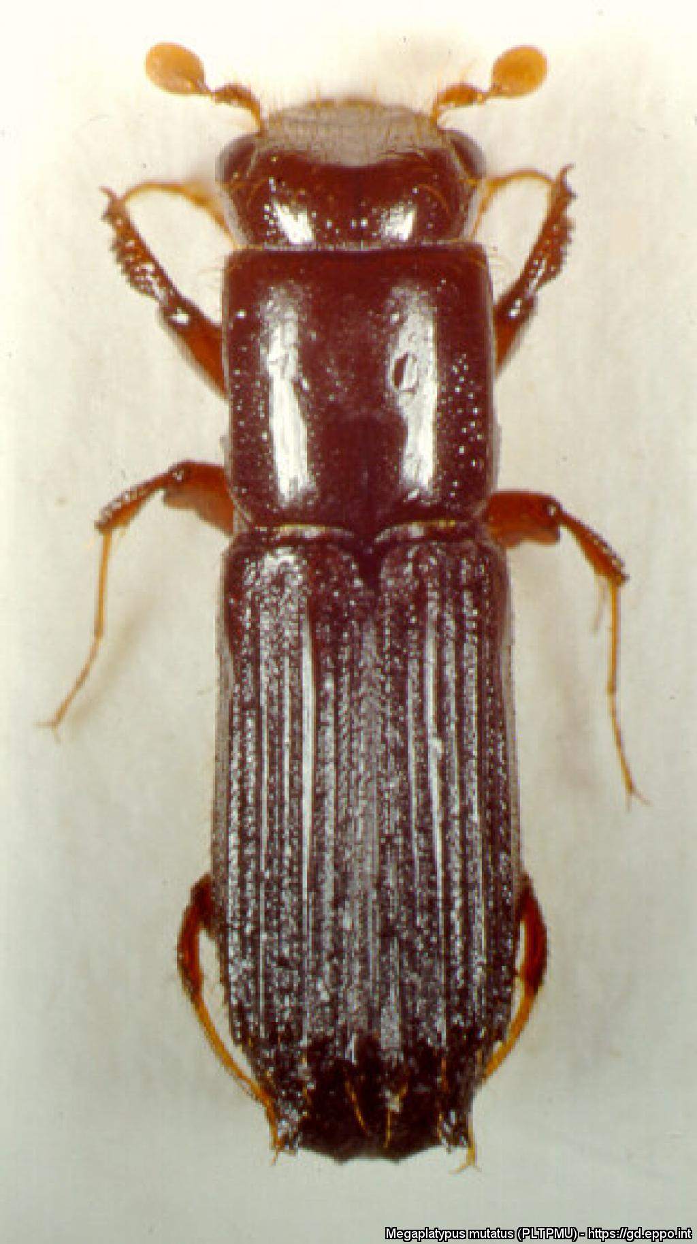
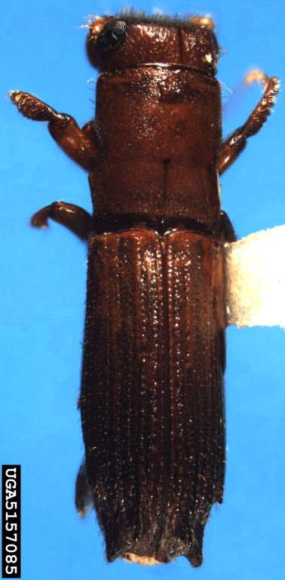
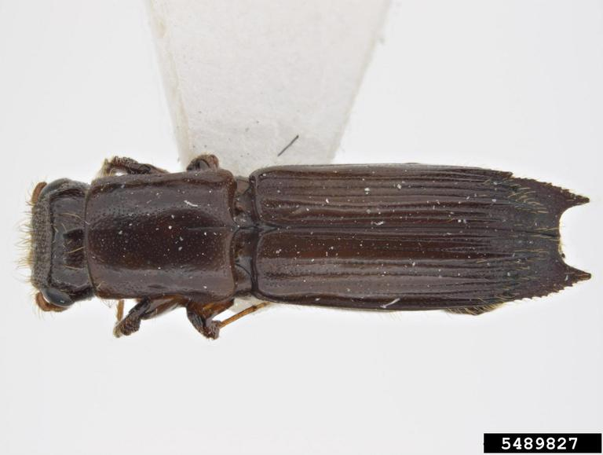
Megaplatypus mutatus
Identification
This beetle subfamily (Platypodinae) is known for its long cylindrical body which is different that most Bark Beetles.
“Larger” bark beetle at 7-8mm
Antennae & feet are reddish, body is brown to black.
There are other Platypodinae species native to the US. They also kill trees but usually after draught or other stressors to the tree.
Native species can be separated from Invasive by “spines” at the end of the wings and shape of neck (pronotum).
Notes:
Insect photo: G. Allegro, CRA- Istituto di Sperimentazione per la Pioppicoltura, Casale Monferrato (IT).
Native insect photos:
Euplatypus compositus: Natasha Wright, Braman Termite & Pest Elimination, Bugwood.org
Mypoplatypus flavicornis: Pest and Diseases Image Library , Bugwood.org
Oxoplatypus quadridentatus: J.R. Baker & S.B. Bambara, North Carolina State University, Bugwood.org
RESOURCES:
https://www.cabi.org/isc/datasheet/42293
http://download.ceris.purdue.edu/file/3071
https://gd.eppo.int/taxon/PLTPMU/datasheet
SCREENING AID: http://download.ceris.purdue.edu/file/2811

Slide 20
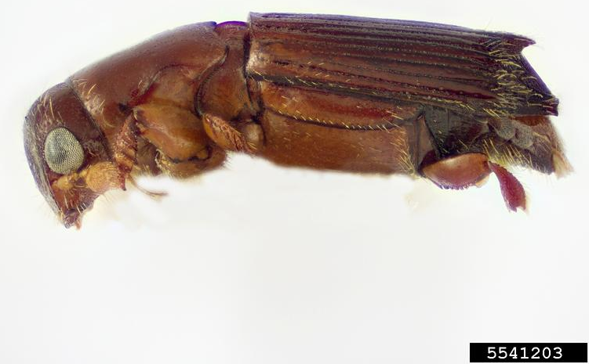
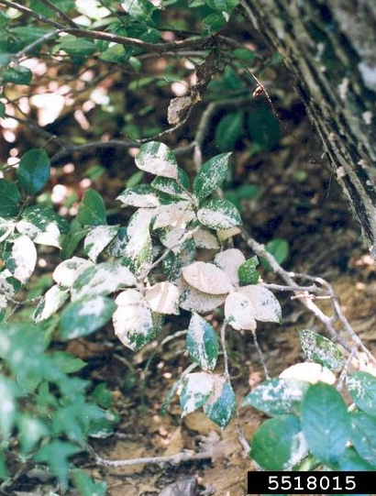
Platypus quercivorus Oak Ambrosia Beetle
Host Species: All Oak species (Quercus spp.), healthy or stressed.
Native to: Japan and Southeast Asia
Symptoms of Infestation:
Adults bore through to the xylem; coarse sawdust and sap found around the holes.
These “frass” materials can cover nearby plants
Economic & Ecological Damage:
Can spread Japanese Oak Wilt fungus which is fatal to Oaks.
Killing our native Oak species harms the lumber & furniture industries and our natural ecosystems.
Notes:
Insect Photo: Joseph Benzel, Screening Aids, USDA APHIS PPQ, Bugwood.org
Frass materials on plants photo: Troy Kimoto, Canadian Food Inspection Agency, Bugwood.org
JAPANESE OAK WILT: https://www.cabi.org/ISC/datasheet/46687
While the beetle and plant pathogen are native to Japan; this complex is wreaking havoc and causing “mass mortality of Oak trees” in Japan since the 1980s.
SCREENING AID: http://download.ceris.purdue.edu/file/2811
RESOURCES:
http://download.ceris.purdue.edu/file/3079
https://www.gbif.org/species/5015452

Slide 21
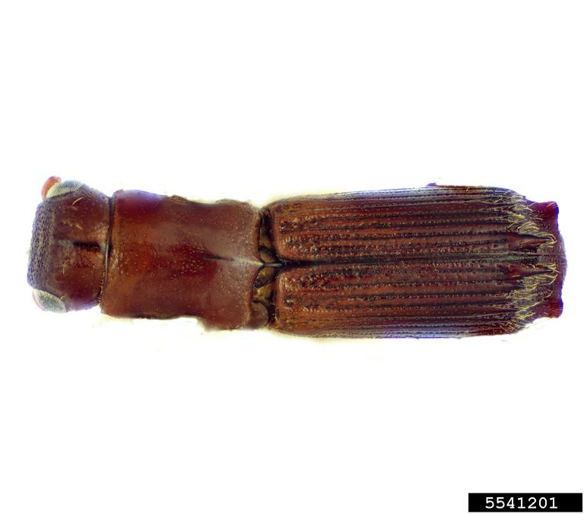
Platypus quercivorus Oak Ambrosia Beetle
Identification
Same subfamily as M. mutatus – has a long and cylindrical body
Smaller than M. mutatus at 4-5mm
Antennae & feet are reddish, body is brown to black.
Separated from M. mutatus by “spikes”
There are other Platypodinae species native to the US.
Native beetles can be separated from Invasive by “spines” at the end of the wings and shape of neck (pronotum).
Notes:
Insect photo: Joseph Benzel, Screening Aids, USDA APHIS PPQ, Bugwood.org
Native insect photos:
Euplatypus compositus: Natasha Wright, Braman Termite & Pest Elimination, Bugwood.org
Mypoplatypus flavicornis: Pest and Diseases Image Library , Bugwood.org
Oxoplatypus quadridentatus: J.R. Baker & S.B. Bambara, North Carolina State University, Bugwood.org
RESOURCES:
SCREENING AID: http://download.ceris.purdue.edu/file/2811

Slide 22
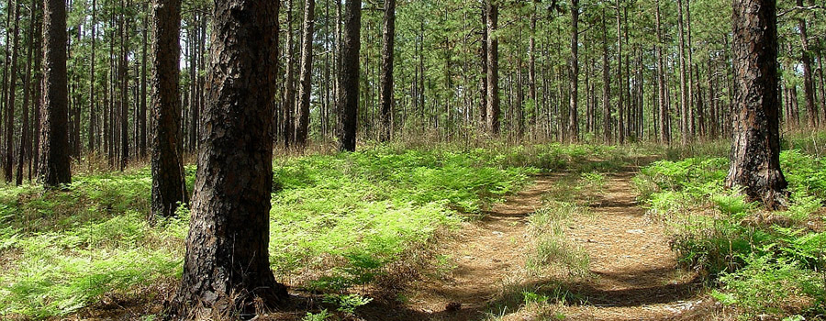
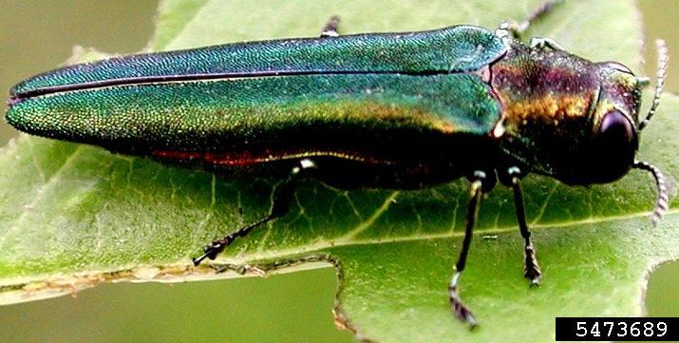
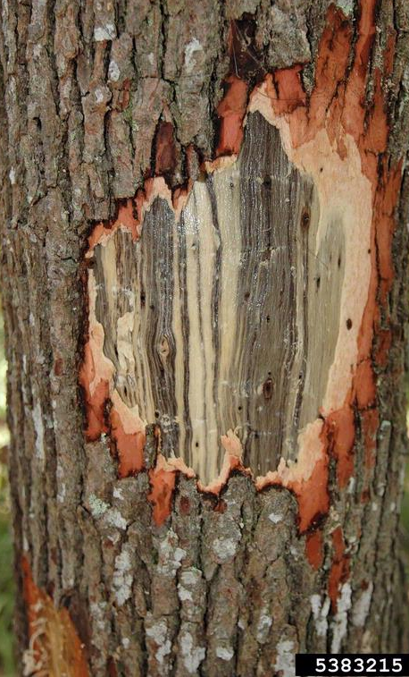
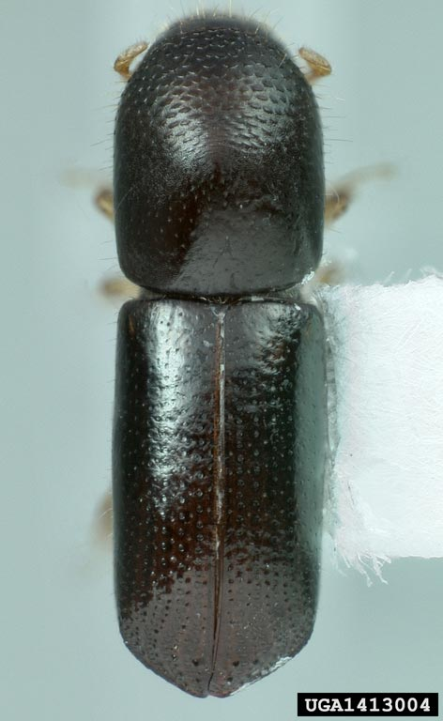
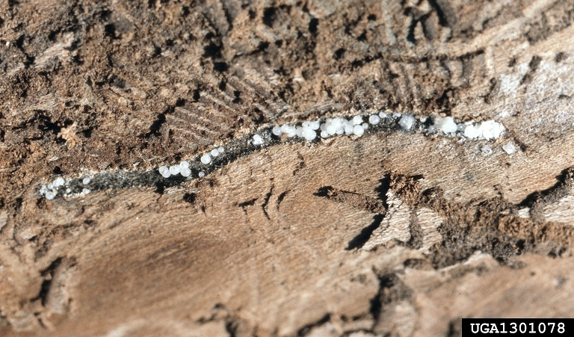
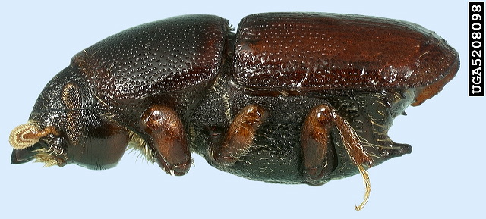
Invasive Forest Pests present in Texas
Emerald Ash Borer
Redbay Ambrosia Beetle
Laurel Wilt Disease
Smaller European Elm Beetle
Dutch Elm Disease
Notes:
EAB on Leaf photo: Leah Bauer, USDA Forest Service Northern Research Station, Bugwood.org
RAB photo: Michael C Thomas, Bugwood.org
Laurel wilt killing a Redbay tree: Ron Billings Texas A&M Forest Service, Bugwood.org
Insect Photo: Natasha Wright, Braman Termite & Pest Elimination, Bugwood.org
Dutch Elm Fungus: Joseph OBrien, USDA Forest Service, Bugwood.org

Slide 23
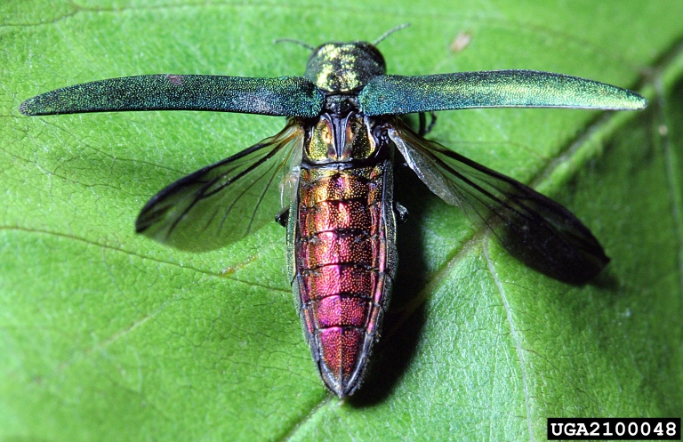
Invasive Forest Pests present in Texas
Emerald Ash Borer Agrilus planipennis
Native to: Northeastern Asia
Host Species: Ash trees (Fraxinus sp).
It quickly kills healthy Ash trees
Cost the US billions of dollars in economic damage and funding to repair forests, urban areas and riparian ecosystems.
In Texarkana and DFW areas
Identification:
Green metallic body with red under wings. Very important!
D-shaped exit holes on Ash trees.
Bark peels to show feeding galleries.
Notes:
Location linked to PDF showing EAB positive locations (map created by US Forest Service) at: https://www.aphis.usda.gov/plant_health/plant_pest_info/emerald_ash_b/downloads/NewCountyDetectionMap2021.pdf
RESOURCES:
https://www.invasivespeciesinfo.gov/terrestrial/invertebrates/emerald-ash-borer
https://www.aphis.usda.gov/aphis/ourfocus/planthealth/plant-pest-and-disease-programs/pests-and-diseases/emerald-ash-borer
SCREENING AID: http://download.ceris.purdue.edu/file/535
PHOTOS:
EAB on Leaf photo: Leah Bauer, USDA Forest Service Northern Research Station, Bugwood.org
EAB showing red underside: David Cappaert, Bugwood.org
D-shaped Holes: Joseph O’Brien USDA Forest Service, Bugwood.org

Slide 24
Invasive Forest Pests present in Texas
Redbay Ambrosia Beetle Xyleborus glabratus
Native to: India to Japan
Host Species: Redbay, Sassafras and Avocados
Transmits harmful Laurel Wilt Disease which kills infected trees.
Trees dieback at canopy. Leaves quickly turn brown. Tree vascular tissue becomes discolored (pictured)
Since the beetle is tiny (2mm), infestation is not usually identified until Laurel Wilt symptoms appear.
PRESENT IN EAST TEXAS!!
Economic and Ecological Damage: Poses threat to US & Mexico Avocado industry. Damage to FL Avocado industry estimated at $5 Million.
Ecological: Redbay and Sassafras are integral trees for Southeastern US Forests.
Notes:
RESOURCES:
ID HELP: https://entnemdept.ufl.edu/creatures/trees/beetles/redbay_ambrosia_beetle.htm
https://cisr.ucr.edu/invasive-species/redbay-ambrosia-beetle-and-laurel-wilt
LAUREL WILT INFO & MAPPING: https://www.invasivespeciesinfo.gov/terrestrial/pathogens-and-diseases/laurel-wilt
“EAST TEXAS” linked to PDF showing the current status of Laurel Wilt as of 2021. Map is updated through the USDA Forest Service andlink is always at invasivespeciesinfo.gov.
https://epi.ufl.edu/pathogens/plant-pathogens/laurel-wilt/#:~:text=DISEASE%20SYMPTOMS%201%20Flagging%20of%20shoots%20near%20the,do%20not%20abscise%20from%20shoots%203%20Vascular%20discoloration
RAB photo: Michael C Thomas, Bugwood.org
Laurel wilt damage: Ron Billings Texas A&M Forest Service, Bugwood.org

Slide 25
Invasive Forest Pests present in Texas
Smaller European Elm Beetle Scolytus multistriatus
Native to: Europe
Host Species: Elm species (Ulmus spp)
Transmits harmful Dutch Elm Disease, a fungus that kills infected elms.
Dutch Elm first reported in US in 1930s
Dieback at canopy, called “flagging”.
Brown/black streaking under bark appears in infected branches.
Concentrated efforts have led to management of this pest, but we must remain vigilant.
Identification: Scolytus beetles have a “point” on the underside of their body; but the beetles are quite small (3mm).
Usually signs of dying elm show before infestation is spotted.
Notes:
Insect Photo: Natasha Wright, Braman Termite & Pest Elimination, Bugwood.org
Dutch Elm Fungus: Joseph OBrien, USDA Forest Service, Bugwood.org
BEETLE RESOURCES:
https://content.ces.ncsu.edu/smaller-european-elm-bark-beetle-scolytus-multistriatus
https://www.cabi.org/isc/datasheet/49212
https://www.forestpests.org/subject.html?sub=66
https://www.fs.usda.gov/Internet/FSE_DOCUMENTS/stelprdb5347208.pdf
BEETLE MAP: https://www.fs.fed.us/nrs/tools/afpe/maps/pdf/SEEBB.pdf
DUTCH ELM DISEASE RESOURCES:
https://www.invasivespeciesinfo.gov/terrestrial/pathogens-and-diseases/dutch-elm-disease
https://extension.unh.edu/resource/dutch-elm-disease-fact-sheet
MAP: https://www.fs.fed.us/nrs/tools/afpe/maps/pdf/DED.pdf
TREATMENT: https://www.forestwildlife.org/how-to-treat-dutch-elm-disease/

Slide 26
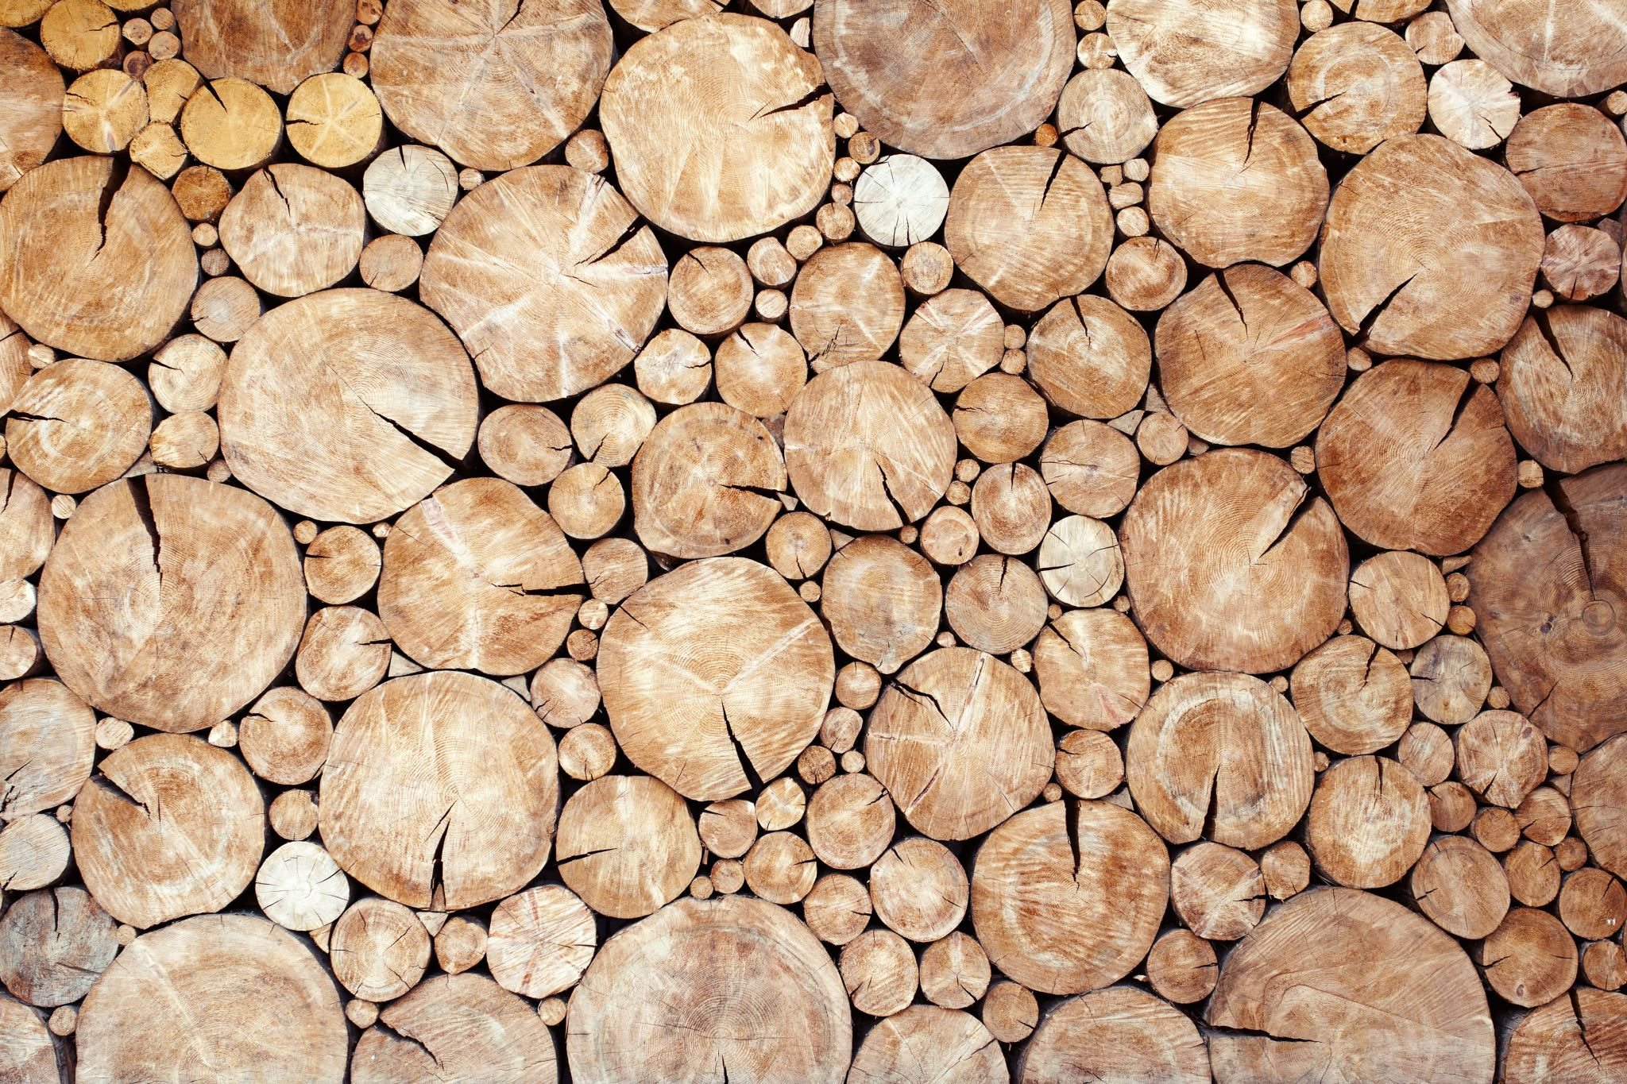
Initiatives on Wood Pests
Human awareness is the most important step to stop the unintentional spread of invasive species.
Recall that Humans are the main cause behind the spread of Invasive Species
Many programs targeted towards preventing the spread of Wood Pests.
“Don’t move Firewood” one example of a major public education campaign to inform citizens about what we can do to control the impact of invasive species.

Slide 27

Initiative Examples
Notes:
Remember this when camping or traveling!
Read the bulleted items; those are integral to stopping the spread of these pests.
**IMPORTANT**
Whether native or invasive, bark beetles WILL spread to other trees. If you have a tree that died of beetle infestation you must cutdown the infested treat and finely mulch it. Then spray (with pesticide) or burn the mulch pile to prevent spread. Look for signs of beetle infestation whenever you’re scrapping wood from your property, a neighbor, etc. Those can often carry native bark beetles that will kill trees showing stress.

Slide 28
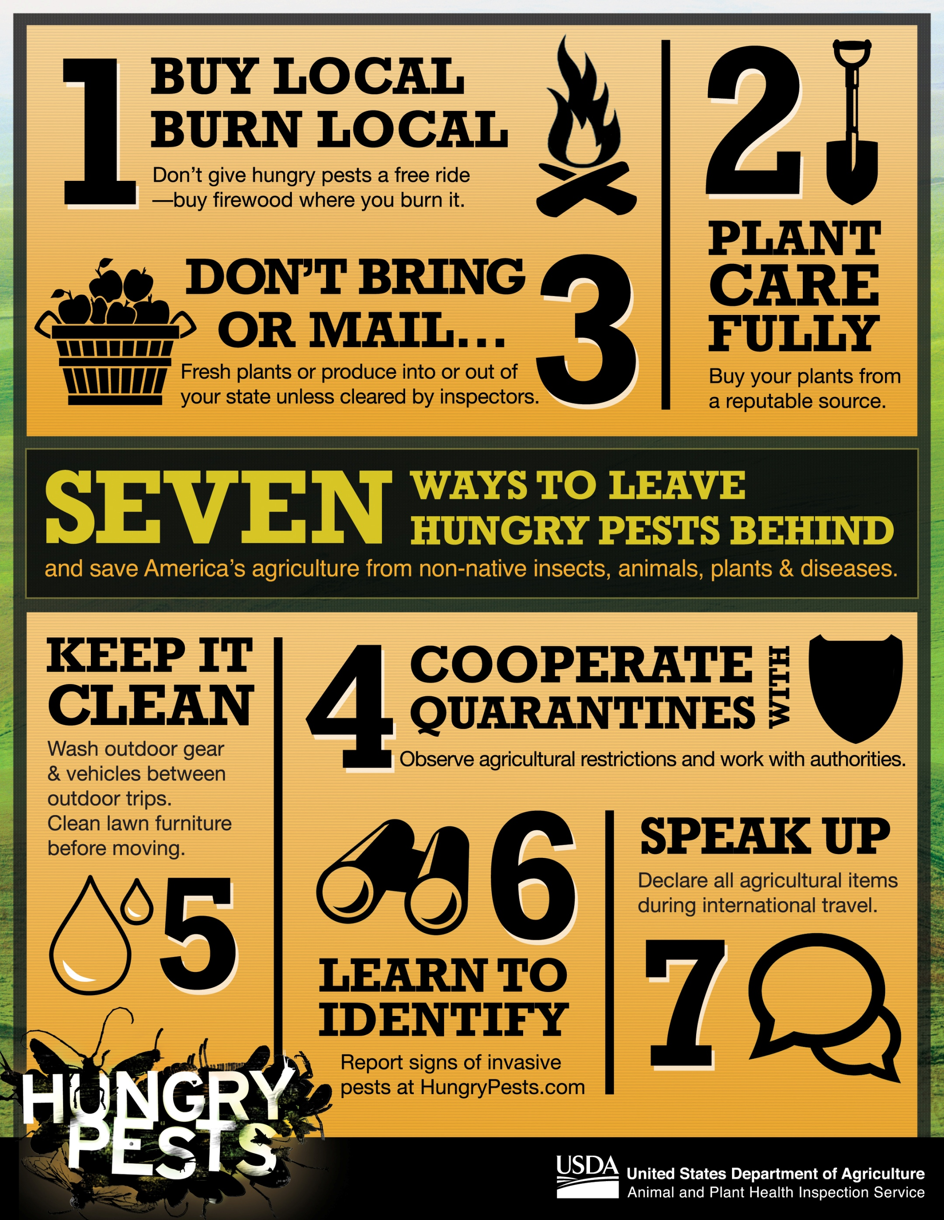
Initiative Examples
Hungrypests.org is a USDA-run education program that has great resources
Notes:
Buy Local, Burn Local (covered in previous slide)
Plant Carefully- we’ll discuss this more in Lesson 8 and 9 (Invasive Plant & Transmission Pathways)
Don’t Bring of Mail – These limitations are put in place to stop humans from accidentally shipping invasive crop or fruit pests
Cooperate with Quarantines – Think back to the Citrus Greening Quarantine and why adhering is so important; the insect and disease cannot travel long distances and it has only spread widely by unaware citizens.
Keep it Clean – Making sure any hiking, boating or camping equipment is clear of debris- we’ll discuss this more in Lesson 8 and 9 (Invasive Plant & Transmission Pathways)
Learn to Identify- Students getting the advantage with this curriculum. They can also go to the other resources listed throughout presentations and at the end of Lesson 10 to keep learning!
Speak Up – By declaring agricultural items during international travel, you are directly preventing the spread of Invasive Species. Recall Lesson 1 discussing how APHIS Customs helps provide a line of defense against Invasive Species from people traveling into the country.

Slide 29

Initiative Examples
Notes:
Know your Roots ties into “Plant Carefully”
It can be important when purchasing seeds to know your source. Often, companies from overseas will mix in other seeds of invasive plants.
Hunt for Holes- That is the lesson from today! If your tree is starting to look sick- hunt for holes and check for other signs of bark beetle infestation.
Soak ‘em in Soap: Gypsy Moths are not present in Texas, but this strategy can be used for many types of insect eggs.

Slide 30
Initiatives on Wood Pests
You get 10 minutes to go into groups of two and create a brand-new initiative using the information you learned today.
Make sure to include illustrations, hashtags, and other aspects that can get the attention of the public.

Slide 31


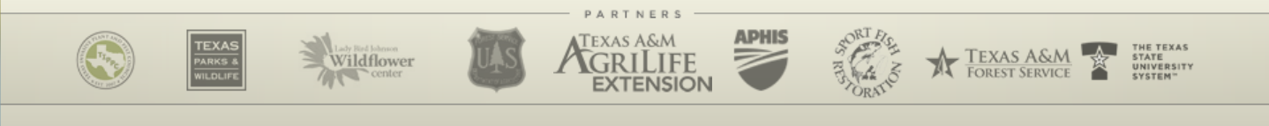
Notes:
Next we’ll discuss how YOU can help prevent the spread of invasives.

